Slide 1

Cyclistic Bikes Case Study
The data for this project is provided by: Data License Agreement | Divvy Bikes The company name, Cyclistic, is fictional.

Slide 2
I am a (fictional) junior data analyst with responsibility for one question at a fictional company. This is the answer to the one question. The code is in the R file on GitHub. How do annual members and casual riders use cyclistic bikes differently?
The data was from the company and meant for a study for the company, so I valued it as safe. It’s beneficial to use a large amount of data. I used all the data from 2023. That meant pasting 12 CSV files together to make one dataframe. From there, I had 5.7 million rows of data. After data cleaning, the row number went down to 4.3 million. I divided the data into members and casuals and made two different dataframes. I added a few lines of code and produced some visualizations. Below are the visualizations and conclusions from those visualizations.

Slide 3
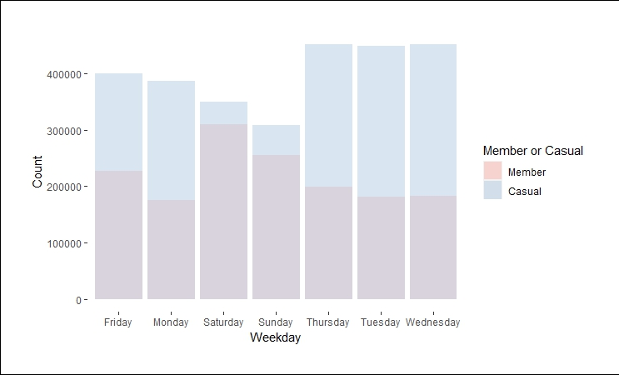
Cyclistic usage by day of the week. As you can see, members use the Cyclistic services much more than casual users. The gap narrows significantly on the weekend, however.

Slide 4
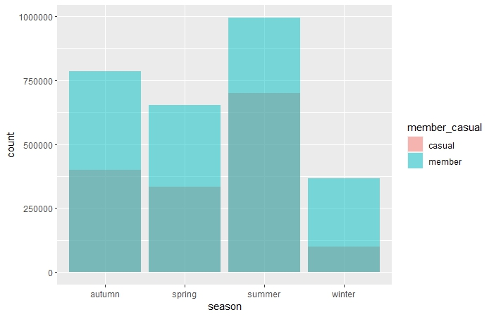
Seasonal use between members and casual users. As expected, all use is lower in the winter. Members still use the service more in the winter by a 3:1 ratio.

Slide 5
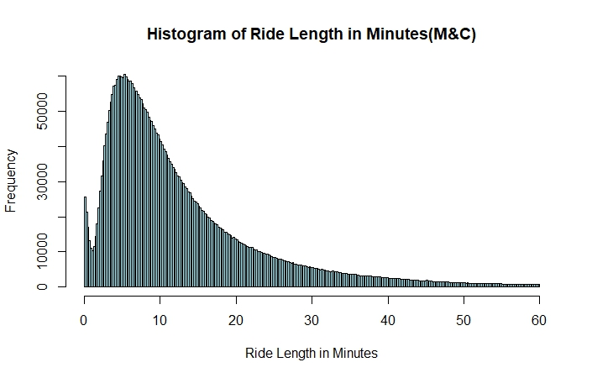
This is a histogram of ride length in minutes for both members and casual users. Most rides are less than 40 minutes in length. This is true for members and casual users. The bulk of the ride lengths are less than 10 minutes. This does show most of the 4.3 million rides. There are a few rides over sixty minutes, but they are left out. Still, casual riders averaged 22.9 minutes and members averaged only 12.13 minutes per ride. This is inclusive of all rides.

Slide 6
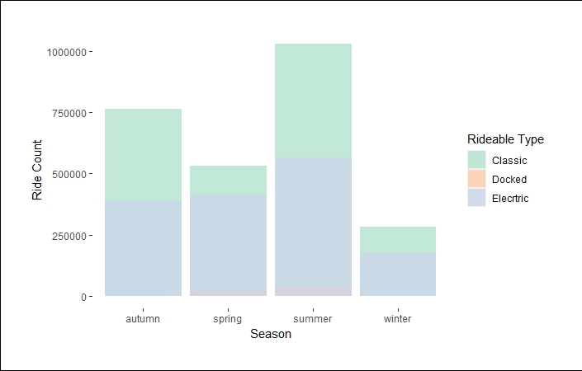
Rideable type usage by season. Winter is the low use period, and the classic type is the most used.

